Slide 1
KEYLOGGER
CAPSTONE PROJECT
Presented By:
s.Mariam Jerina- Jeppiaar Institute of Technology – B.Tech/ Information Technology

Slide 2
OUTLINE
Problem Statement
Proposed System/Solution
System Development Approach
Algorithm & Deployment
Result
Conclusion
Future Scope
References

Slide 3
PROBLEM STATEMENT
Develop a basic keylogger application using Python.
The application should capture keyboard events such as key press, key hold, and key release
, and save the captured keystrokes into both a text file (key_log.txt) and a JSON file (key_log.json)
. The application should provide a graphical user interface (GUI) using Tkinter, allowing users to start and stop the keylogger.

Slide 4
PROPOSED SOLUTION
The proposed system is a Python application that utilizes Tkinter for the GUI and the Pynput library for capturing keyboard events. It consists of two main components:
Keylogger Functionality: The application captures keyboard events using the Pynput library. When a key is pressed, held, or released, the corresponding event is logged. These logs are then stored in memory.
GUI: The Tkinter library is used to create a simple GUI with two buttons: "Start" and "Stop". Users can click the "Start" button to initiate the keylogger, and the "Stop" button to halt it.

Slide 5
SYSTEM APPROACH
Technology Used:
Implement Keylogger Functions: Develop functions to handle key press and release events, as well as functions for logging keystrokes into text and JSON files.
Design GUI: Create a graphical interface using Tkinter with buttons to start and stop the keylogger.
Integrate Keylogger with GUI: Connect the keylogger functions to the GUI buttons to enable users to control the keylogging process.
Test and Debug: Verify that the application functions correctly by testing various scenarios and handling potential errors.

Slide 6
ALGORITHM & DEPLOYMENT
Initialize the Tkinter window.
Create GUI elements: labels and buttons.
Define functions to start and stop the keylogger.
Implement key press and release event handlers to log keystrokes.
Write functions to save logs into text and JSON files.
Connect GUI buttons to the corresponding keylogger functions.
Deploy the application for use.

Slide 7
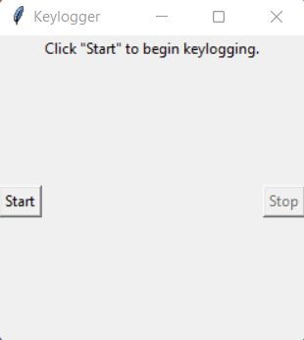
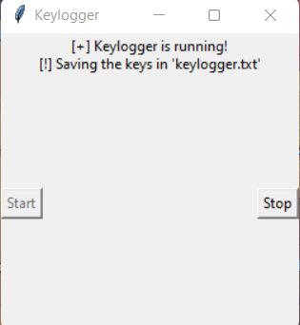
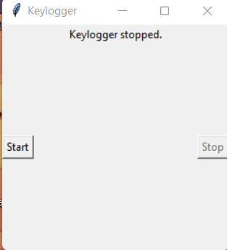
RESULT
The result is a functional keylogger application with a user-friendly GUI. Users can start and stop the keylogger as needed, and all captured keystrokes are saved into text and JSON files for later analysis.

Slide 8
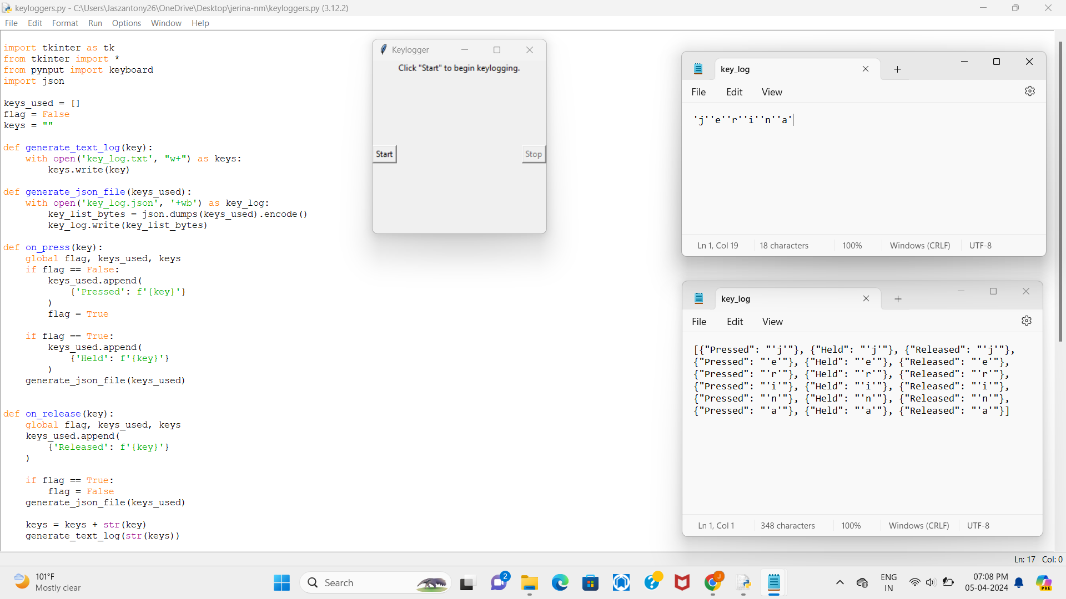
OUTPUT

Slide 9
CONCLUSION
In conclusion, the developed keylogger application provides a basic yet effective solution for capturing keyboard events. It can be used for various purposes such as monitoring user activity, debugging, or educational purposes. However, it's essential to use such tools responsibly and ethically.

Slide 10
FUTURE SCOPE
Enhanced Logging: Implement advanced logging features such as timestamps and additional metadata.
User Authentication: Integrate user authentication mechanisms to ensure authorized access to the keylogger.
Remote Monitoring: Enable remote monitoring capabilities to access keystroke logs from multiple devices.
Improved User Interface: Enhance the GUI with more features and customization options for better user experience.

Slide 11
REFERENCES
Python Documentation: https://docs.python.org/
Tkinter Documentation: https://docs.python.org/3/library/tkinter.html
Pynput Documentation: https://pynput.readthedocs.io/en/latest/
JSON Documentation: https://docs.python.org/3/library/json.html

Slide 12
THANK YOU

